Slide 1


SAP UI5 & FIORI with OData TRAINING using BAS
Anubhav Oberoy
Day – 3

Slide 2

Agenda – Day 3
Inline and Internal JS
Changing CSS at runtime
Adding Dynamic Content
Debugging
Synchronous and Asynchronous Response
External JS
What is NodeJS?
NPM – Node Package Manager

Slide 3

























Slide 4
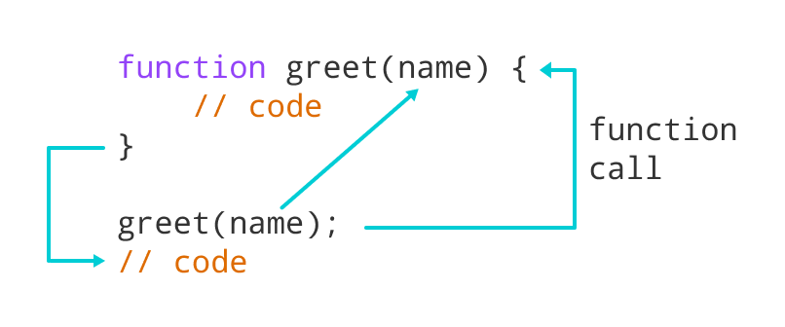
Function in JavaScript
Functions in JavaScript
A JavaScript function is a block of code designed to perform a particular task.
A JavaScript function is executed when "something" invokes it (calls it).
A JavaScript function is defined with the function keyword, followed by a name, followed by parentheses ().
The code to be executed, by the function, is placed inside curly brackets: {}
Function parameters are listed inside the parentheses () in the function definition.
Function arguments are the values received by the function when it is invoked.
Inside the function, the arguments (the parameters) behave as local variables.
Types of functions
Functions are of 2 types 🡪
1. Anonymous function 2. Named Function
function(params) {
//code
}
function functionName(params) {
//code
}

Slide 5
How to Apply JavaScript
JavaScript can be applied to an HTML Page in three ways
Inline JS – The script code is applied at html element level using events e.g., onclick, ondblclick, onhover, onkeypress. This is not recommended as its not reusable.
Internal JS – We write script code inside a script tag. We can use functions for that. There are 2 types of function. Which means it is reusable.
External JS – JS code is written in another file which has extension as .js. We will link it with our script tag. In the same way we linked CSS with link tag.
List of JavaScript Events:
https://www.w3schools.com/jsref/dom_obj_event.asp
document: document is the object of DOM, it is used to access the DOM elements easily. It’ll provide ready to use API (functions) which are built in to access objects of DOM elements (html element).
getElementsByClassName
getElementsByTagName
getElementById

Slide 6
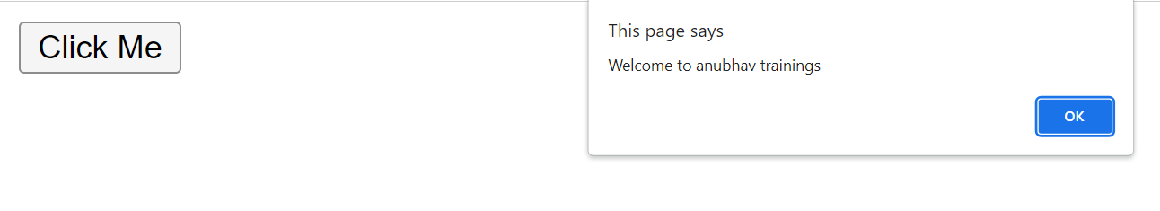
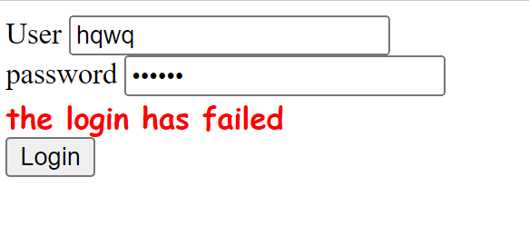
Hands – on: Inline and Internal JS
Now will apply JavaScript to our HTML page using the Inline and Internal method.
For this exercise we will create a new file named JSBasics.html in our current folder.
Part 1: Inline JS
We will create a button in the HTML page using the <button> tag and on press of that button we will show an alert message to the user.
Code Link:
JSBasics.html
Part 2: Internal JS
We will create to a form using the <label> and <input> tag in the page. It will have a username and password field. When the user enter the same value in both of the field and press the login button show success to the user else show error.
Code Link:
JSBasics.html

Slide 7
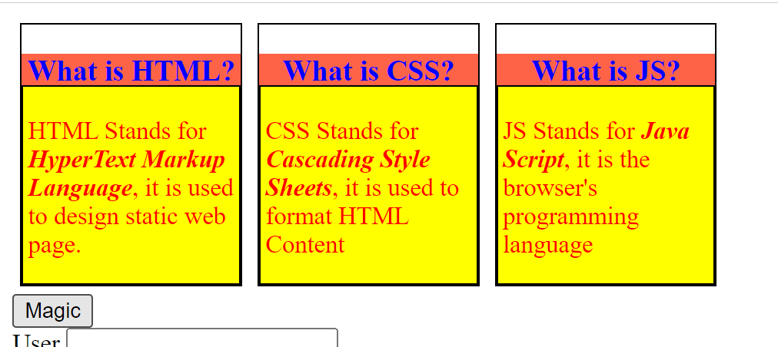
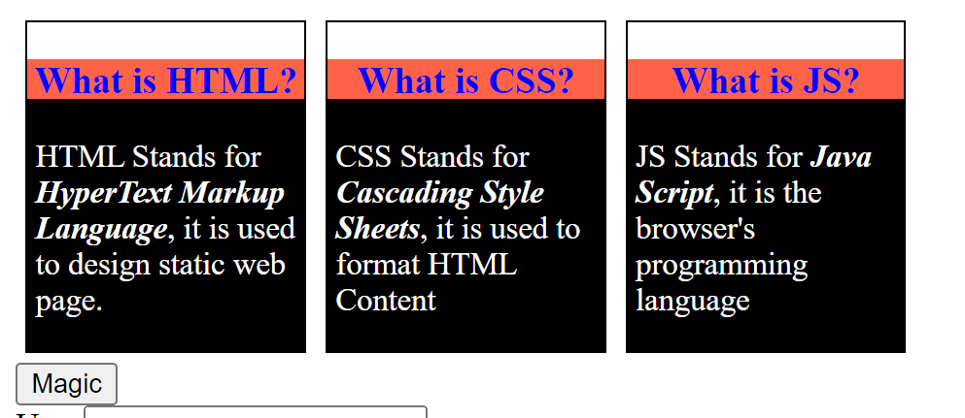
Hands – on: Changing the CSS at runtime
Now we will change the style properties of the elements in the HTML page at the runtime.
For this we will add a Magic Button on the page, on press of that we will change the color of the box-content.
Code Link:
JSBascis.html

Slide 8
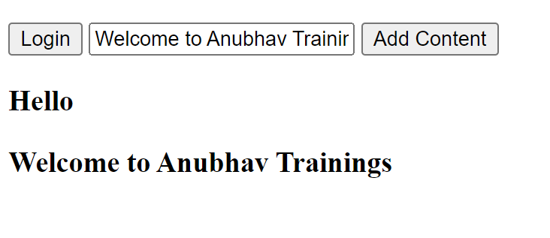
Hands – on: Adding Dynamic Content
Now we will see how to add content dynamically to our HTML page at runtime.
For this we will add a new input field and a button to the page and on press of the button whatever is written in the input field will be printed on the page.
Code Link:
JSBasics.html

Slide 9

Debugging
Debugging is the process of detecting and removing of existing and potential errors (also called as 'bugs') in a software code that can cause it to behave unexpectedly or crash.
In order to debug our code, press F12 in browser window and go to the Source tab. In source tab set up the Break point by clicking on the line number.
Shortcuts for debugging are shown below:
Type | ABAP | JS
Step-in | F5 | F11
Step-out | F7 | Shift+F11
Go to next | F6 | F10
Continue (till Next BP) | F8 | F8
There are several tabs in the console, while working on the application we are mainly focused on Console, Elements, Source and Network Tab.
Console: It is the place where we run the JavaScript Code and Print the output for testing and Debugging
Elements: It shows the DOM of the current page open in browser.
Source: All the JavaScript code of the app or page will be visible here. We can also debug the code form here.
Network: We can see all the Network related calls made by the application in this section.

Slide 10
Synchronous and Asynchronous Response
User
Screen
Server
Database
Save
Processing
Time
Request send to server
Request to Database
Synchronous Response
For all this time user
Remains blocked
Response form Database
Save
Request send to server
For all this time user
Remains blocked
Request to Database
Asynchronous Response
For all this time user
Is Not Blocked
Response from the server
Response form Database
Callback / Promise

Slide 11
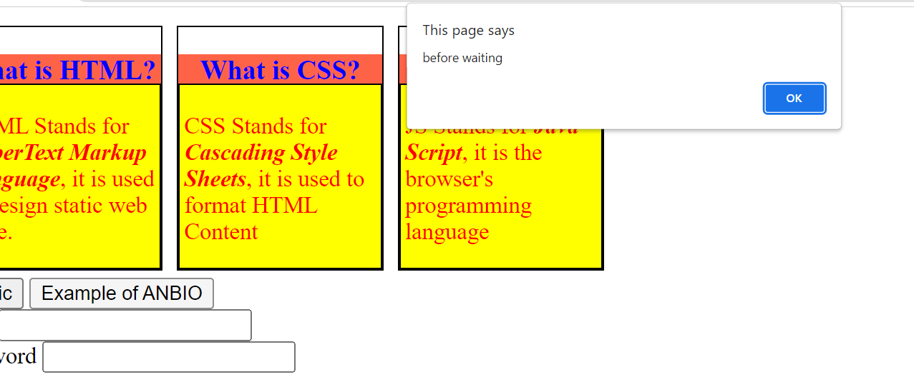
Hands – on: Async Behavior of JS
Now we will see how JavaScript works asynchronously.
We will also see how to use the Callback function in JS.
Code Link:
JSBasics.html

Slide 12
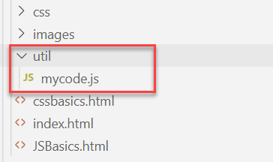
Hands – on: External JS
Create a new utils folder in the current webapp folder and in that utils folder create a new mycode.js file.
Move all the code written in the <script> tag to the new mycode.js file.
Code Link:
JSBasics.html
mycode.js

Slide 13




















Slide 14

What is NodeJS?
Node JS is an open-source, cross platform, JavaScript runtime environment and used to execute JavaScript on Server Side.
Node JS is a framework which allows us to run JS code outside browser. The main benefit is that a development do not need to learn multiple programming languages. If we know JS, we can code both client and server side in same language.
Node JS is also a great web framework for beginners because it works great for data intensive applications like streaming, gaming and real time apps. It leverage the power of JS’s Asynchronous no blocking IO.
Application of Node JS
Build Backend Application Logic
Host a Web Server (express)
Send Emails
DB lookup
Automation
Output to the user
Use its eco-system like PDF, EXCEL, EMAIL…
Install NodeJS in our system form here https://nodejs.org/en/, if you using bas, you do not need to install as BAS already has NodeJS preinstalled.
If we want to achieve something, this something was already achieved by someone, somewhere else in the world, they have already published it as a node module which we can import and reuse. We get ready-to-use code for consumption for speedy development. https://npmjs.com

Slide 15

NPM – Node Package Manager
Node Package Manager (NPM) is a command line tool that installs, updates or uninstalls Node.js packages in your application. It is also an online repository for open-source Node.js packages. The node community around the world creates useful modules and publishes them as packages in this repository.
npm is the world's largest Software Registry.
The registry contains over 800,000 code packages.
Open-source developers use npm to share software.
Many organizations also use npm to manage private development.
npm is installed with Node.js
NPM is included with Node.js installation. After you install Node.js, verify NPM installation by writing the following command in terminal or command prompt ‘npm –v’
https://www.npmjs.com/

Slide 16
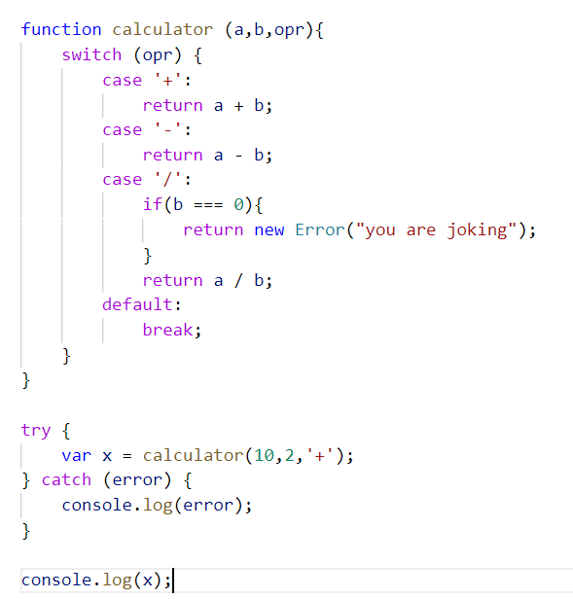
Hands – on: Basic Node Project
Create a new folder named BasicsNode and inside this folder create a new file named basicnode.js.
Now write a line in this file console.log(‘Welcome to NodeJS’);
Now to run this file open the terminal navigate to the BasicsNode folder and write command ‘node ./basicnode.js’
Now we will create a basic calculator function and will see how to use it in the NodeJS.
Code Link:
basicsnode.js

Slide 17
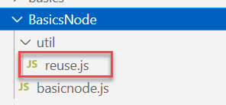
Hands – on: Creating Reusable Modules
Reusable Modules: The modules/library which can be reused at multiple place without writing the same code at multiple place.
Now we will create a reusable module (reuse.js) in our node project under the util folder in our current BasicsNode folder.
Code Link:
basicnode.js
reuse.js

Slide 18
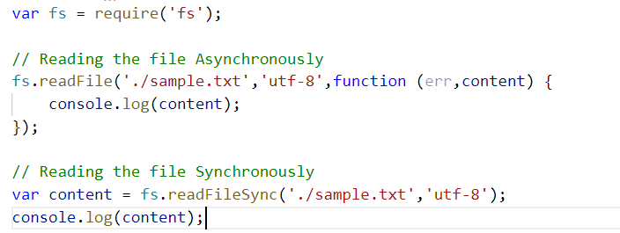
Hands – on: Using Predefined NodeJS modules
Now we will use the fs module (file system module) provided by NodeJS to read the file present in our system.
This is a predefined module which comes with NodeJS, we don’t need to install it separately.
To use this module we have to load it in our project using the require function
var fs = require(‘fs’);
We have to create a sample.txt file which we need to read.
We will see how to read the file in Synchronous and Asynchronous way in NodeJS.
Code Link:
basicnode.js
sample.txt

Slide 19
Steps to create a Fresh NodeJS Project
Run a command called npm init – Create a new Nodejs project
Answer some simple questions like project name, starring file, author, version, description, …
We can give any name to our starring file, but it is recommended to use index.js to follow the best practices.
Create the index.js file.
We can just add some code to this file. Ex: console.log(‘Welcome to anubhav trainings’);
To run the project, we can use the ‘node .’ command in the terminal.
Steps to use an external library using NodeJS
Find the library (module) of your purpose on NPM and check its documentation
To add that module/library as a dependency in our project use the command npm install moduleName
The above command we add that dependency to the package.json file.
Use require statement to use the dependency.
const obj = require(‘moduleName’);
Note:-
When we share our project with other developers then we don’t ship the node_modules with our project. The name of all the required dependencies will be there in the package.json file.
When we setup our project in a new system, we just have to run the npm install command, and it will read the package.json file and install all the dependencies.
npmjs
npm install
Laptop
Project+
Module
Laptop
Project

Slide 20
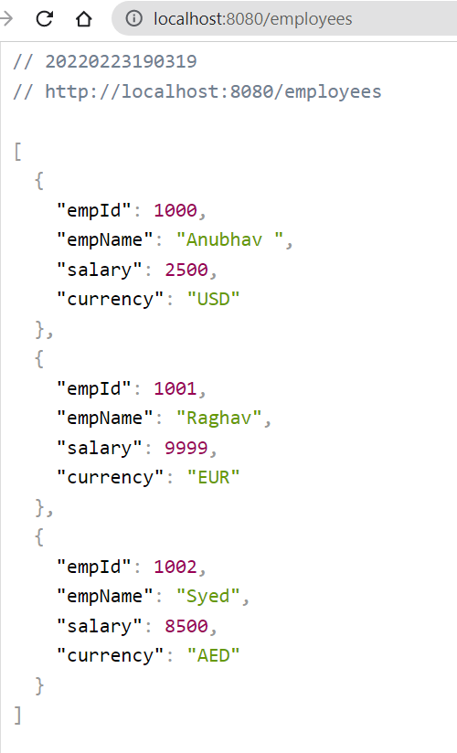
Hands – on: Start a Local Server using Express
Once our Node project is initiated, Now we need to start a local server using the Express module of NodeJS.
But first we need to add this module as a dependency. To add it run the command npm install express.
You can see the express documentation for more details: https://www.npmjs.com/package/express
We will also create local API using the NodeJS
Code Link:
index.js

Slide 21
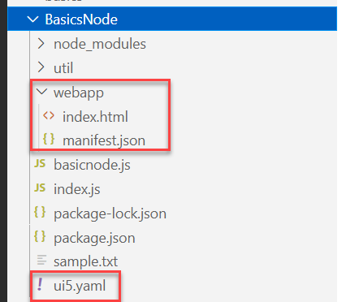
Hands – on: Starting an App using NodeJS
Now we will serve a basic html page on the local server with the help of ui5 tooling.
But before we start we have to install a few dependencies:
ui5 cli:- npm install @ui5/cli to install globally: npm install -g @ui5/cli
ux-ui5 tooling:- npm install @sap/ux-ui5-tooling to install globally: npm install –g @sap/ux-ui5-tooling
Now we have to create a webapp folder in our node project folder, and in that webapp folder create two files index.html and manifest.json.
Also create a ui5.yaml file in the project folder.
Add the required code in all the files form the links provided below.
Now to run the project use command: ui5 serve
Code Links:
index.html
manifest.json
ui5.yaml

Slide 22

Introduction to jQuery
jQuery is a java script library, which is used to simplify our JS code.
The moto is to minimize JS code size.
Why we use jQuery?
It’s free to use (Open Source)
Used by top software companies like google, Netflix, etc.
Light weight JS library
jQuery greatly simplifies JavaScript programming.
Available on internet
Purpose is to write less and do more
Industry standard
How to use?
Download the jQuery library and keep it in our project, just like we use util/mycode.js
Reference jQuery from CDN (Content Distribution/Delivery Network) – directly reference it from internet
Documentation of jQuery is available @ https://jquery.com

Slide 23
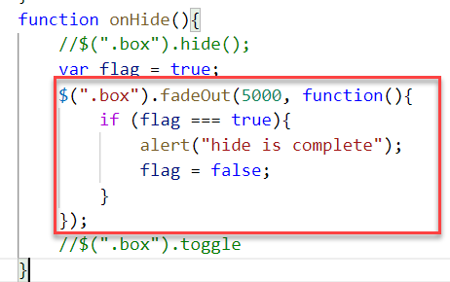
Syntax of jQuery
The jQuery syntax is tailor-made for selecting HTML elements and performing some action on the element(s).
Basic syntax is:
$(selector).action()
$ sign indicated to the browser that we want to use jQuery.
selector: selector is same what we have seen in CSS i.e., #id, .class, tagName
Action(): It is a JavaScript Event or Action which we want to perform on the selected element.
Example:
$("p").hide() - hides all <p> elements.
$(".test").hide() - hides all elements with class="test".
$("#test").hide() - hides the element with id="test".

Slide 24
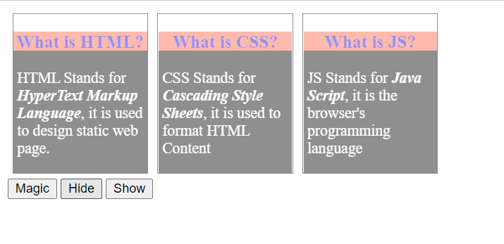
Hands – on: Adding effects using jQuery
Create a new file named jQBasic.html in the Basics folder which we have used for html, css and JavaScript.
Bring the code related to the box and box-content form the previous example.
Now we will add some effects to these boxes using the jQuery actions.
Code Link:
jQBasics.html

Slide 25
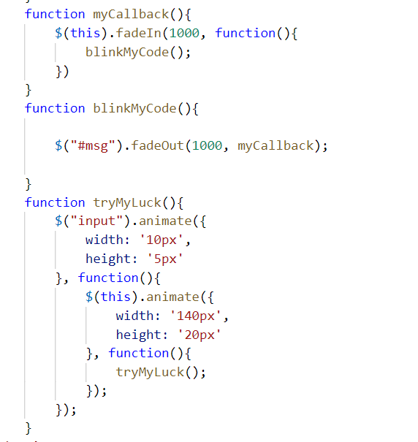
Hands – on: Adding Animation
Now we will add some animations to our html page using the jQuery.
For this we have to bring back the login fields code back form the previous examples.
Code Link:
jQBasics.html

Slide 26

Introduction to UI5
SAPUI5 (SAP user interface for HTML5) or Open UI5 is a collection of libraries that you can use to build desktop and mobile applications that run in a browser. With the SAPUI5 JavaScript toolkit, you can create web applications using HTML5 web development standards.
SAP UI5 is a framework which is used to develop Responsive web applications to run on any platform, any browser and any OS.
Framework: - A framework is a platform for developing software applications. It provides a foundation on which software developers can build programs for a specific platform.
A framework consists of libraries that can be used to process input, manage hardware devices, and interact with system software.
Library: - A collection of Classes.
Classes: - Collection of methods, Attributes, Events.
Your Code
You call the library
Framework call you
Libraries
Framework
Contains

Slide 27
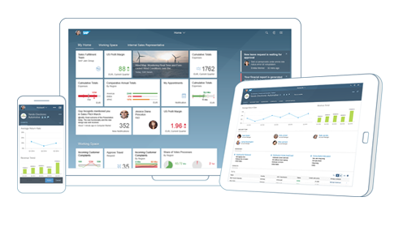
Responsive Web Design
Responsive web design (RWD) is a web development approach that creates dynamic changes to the appearance of a web application, depending on the screen size and orientation of the device being used to view it.
Responsive Web Design is about using HTML and CSS to automatically resize, hide, shrink, or enlarge a website to make it look good on all devices (desktops, tablets, and phones).
Now a days, all the frameworks are designed to adapt the UI according to the screen size of the device.

Slide 28
Structure of UI5 Framework
The UI5 framework is built on top of open standards like HTML5, CSS, JS, and jQuery. UI5 Framework composed of two major components.
1.Design Time Components: It helps us to designing a new application from scratch , it consists of lots of libraries which help to design our application.
2. Runtime Components: It consists of the renderer which is helpful for the conversion of ui5 code into the browser friendly code(HTML+CSS+JS)
The Browser only Understand the HTML , CSS , JavaScript.
BAS or VS Code
App
Creating a App
Using the Libraries
The Runtime component converts the code of application to
SAP UI5 Design Time Component
SAPUI5 Runtime Component
HTML+CSS+JS
sap.m
sap.ui.comp
sap.ui.table
sap.ui.layout
Renderer
sap.ui.core
sap.ui.unified
sap.ui.core.mvc
The browser will now understand the code.
HTML5
CSS
JS
jQuery
Browser

Slide 29
MVC Architecture
MVC Stands for Model , View and Controller.
MVC is a design pattern used in software industries to build applications.
1. Model: It holds the data of the application inside itself.
2. View: It is the output and input interface of the application or can say it is the user interface .
3. Controller : It has all the processing logic inside itself (all written in JavaScript).
The Controller has a event handler to handle the triggered event
eventHandler()
Controller
[Processing]
All processing logic is written in JavaScript because browser only understand JavaScript.
Model will notify the controller back again with the data.
If the event need the data it request the model for the data
The View Triggers a event to the controller.
<<Event>>
The controller get the data and notifies the view back
If we want direct interaction between view and model we use data binding
Model
[Data]
View
I/O
Data Binding
User

Slide 30
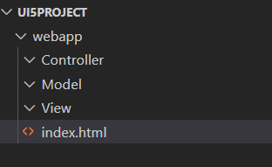
Project Structure of UI5 Project
When you create a new SAPUI5 application, you will be able to see a folder structure created in your project explorer like below.
In a SAP project there are a number of folders and files that you will not recognize if you are not familiar with MVC. Let's have a quick overview.
Within a given project inside the webapp folder , you have three core folders
Model
View
Controller
webapp folder : webapp folder is the root folder of the application in which all the core folders and files of the application were kept.

Slide 31
First UI5 Project in VS Code
Pre-requisites:
We must have node.js v14 or above installed in our system.
We must have sap ui5 tooling installed in our system
npm install –g @ui5/cli (ui5 command line tool)
npm install –g @sap/ux-ui5 tooling (Fiori command tools)
Both are pre-installed in BAS (Business Application Studio)
App creation:-
Initialize a UI5 project , Create a Folder for your project (UI5project) .
We need to create a webapp folder inside our project folder.
inside webapp folder create a manifest.json file
inside manifest.json file create “sap.app”
{
“sap.app”:{
“id”: “mickey”
} }
Now Initialize a node project , In the project terminal run command npm init (auto generate a package.json file).
Now run ui5 init command inside the terminal (ui5.yaml file will generated automatically)
Id is the identifier of the project.
You can give any name as a pet name of the webapp folder

Slide 32
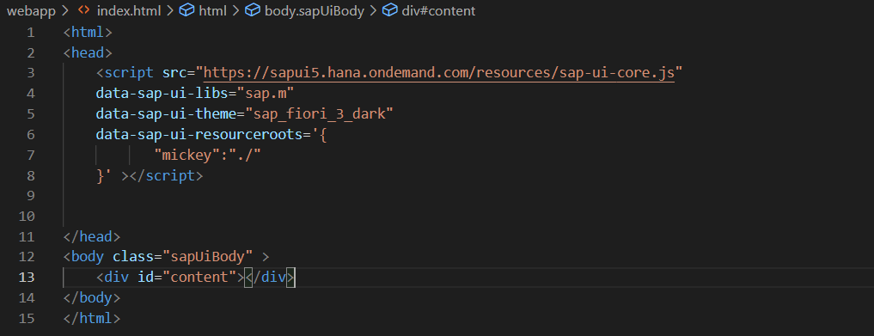
First App Continues……
App-Code:-
Create index.html , load the sapui5 framework from CDN and specify the properties like library and theme
Inside the terminal run command fiori run --open index.html to run your application on the browser.
This is also know asUI5 Bootstrap Code used to initialize the UI5 Framework initially
Here we have to also mention the namespace of the application

Slide 33
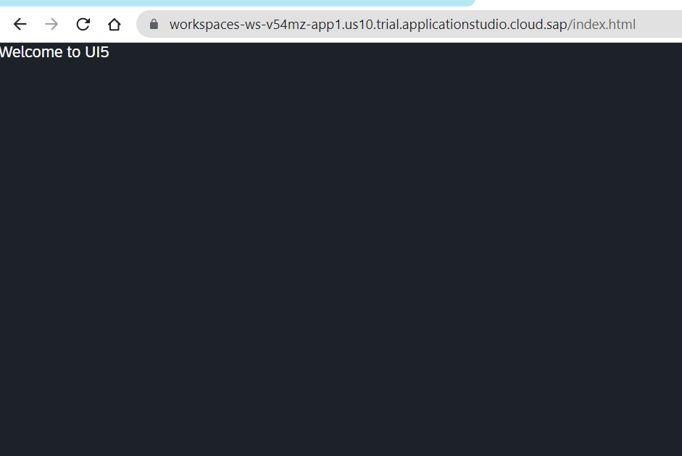
Hands on – Initialize first UI5 Project
Initialize a new ui5 project using the steps mentioned in the previous slide.
Code Link:-
index.html
manifest.json

Slide 34
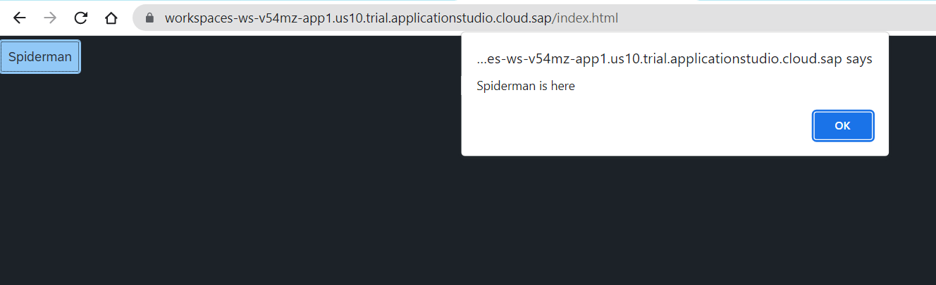
Hands – on: Create a Simple Button Control
Now we will add a simple button control to our app an on press of that button a alert message will be shown to the user, with message “Spiderman is here”.
Code Link:-
index.html

Slide 35

End of Day 3

Slide 36

Questions

Slide 37

Shekhar Vedi

Slide 38






We’re committed to empower you to be
Most Desirable Resource
through powerful training solutions.
We build the workforce of the future.
250+
Corporate Clients
30,000+
Learners Trained
25000+
Learners Placed
FREE WEBINARS
Sign up for free webinars with industry experts every fortnight!
Enroll Now!
Contact us today!
https://anubhavtrainings.com/

Slide 39
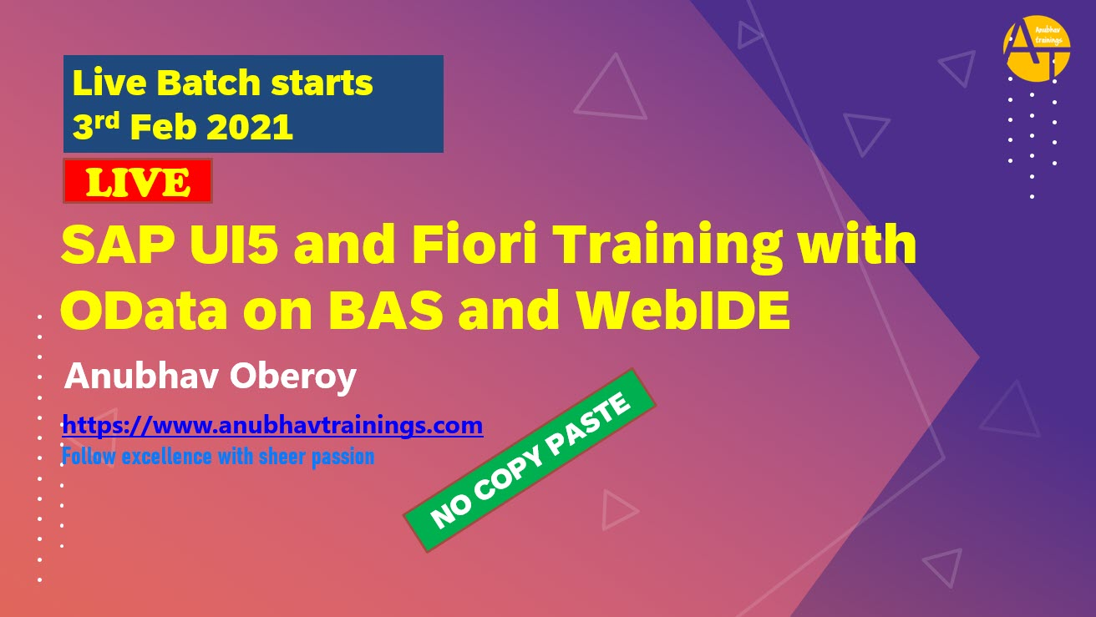


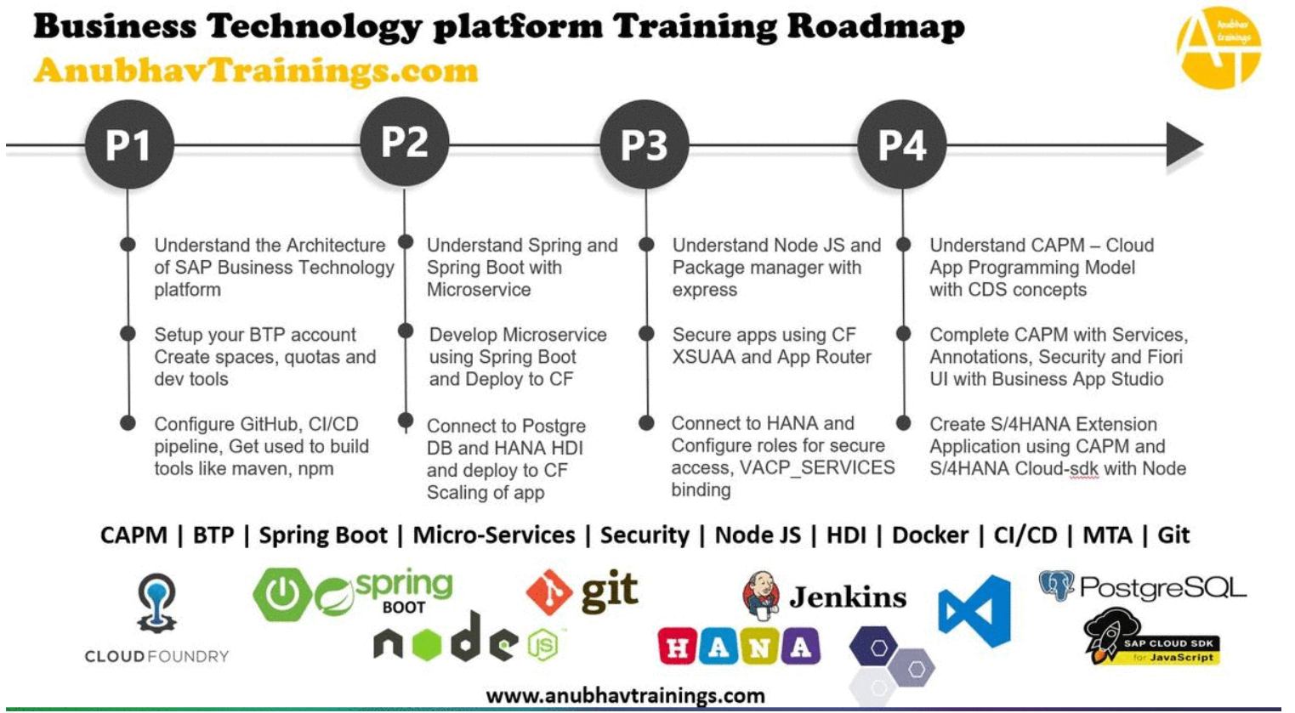
More from AnubhavTrainings.com

Slide 40
Title
Content

